Slide 1

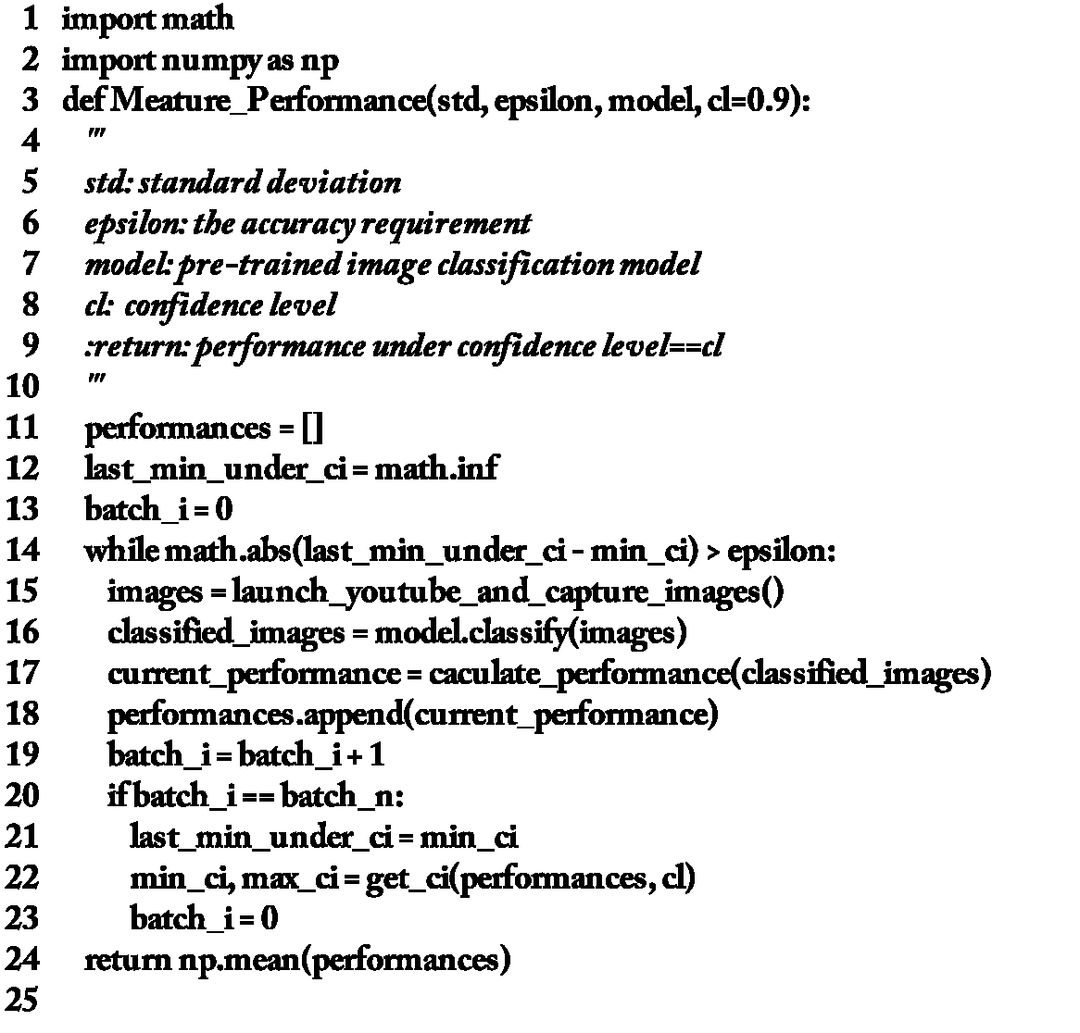

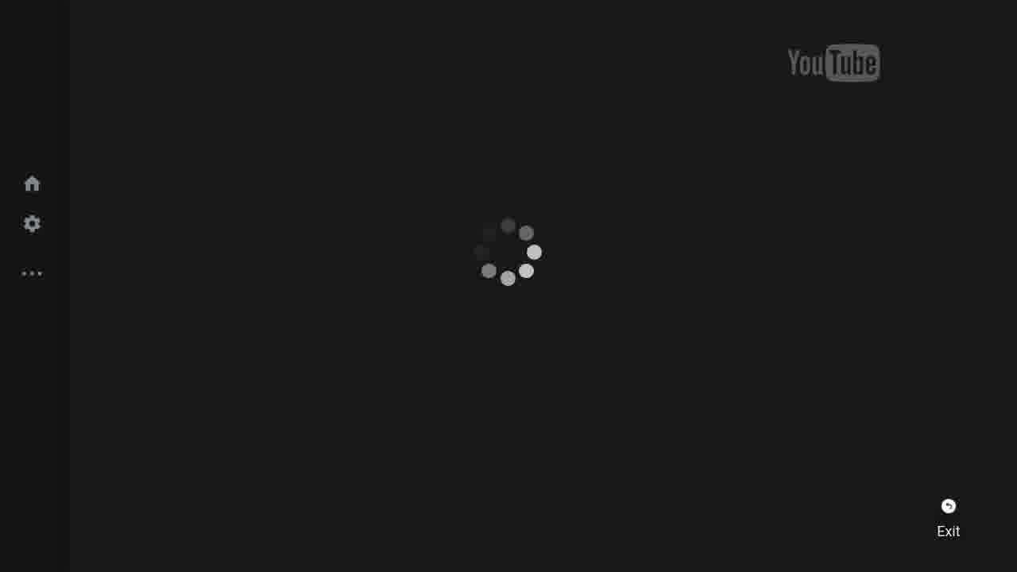
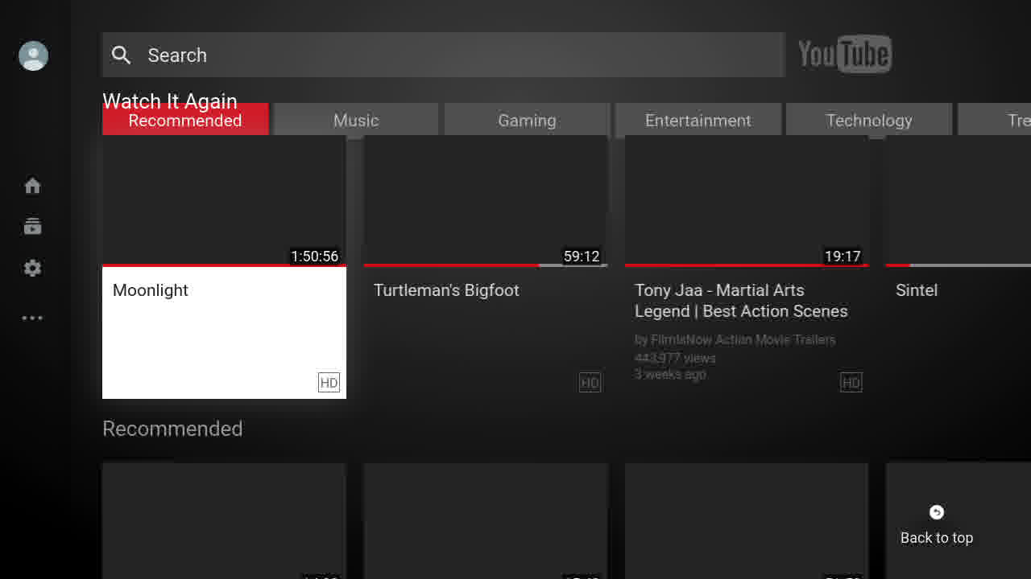
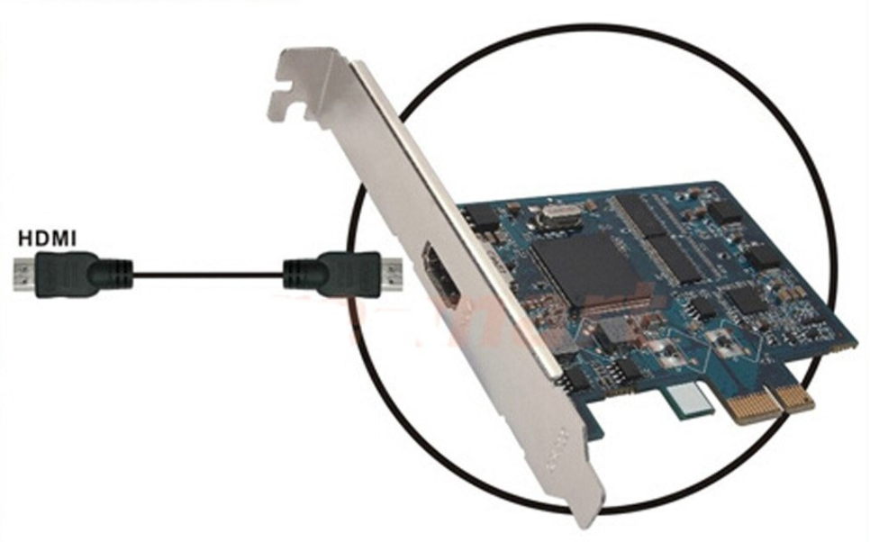
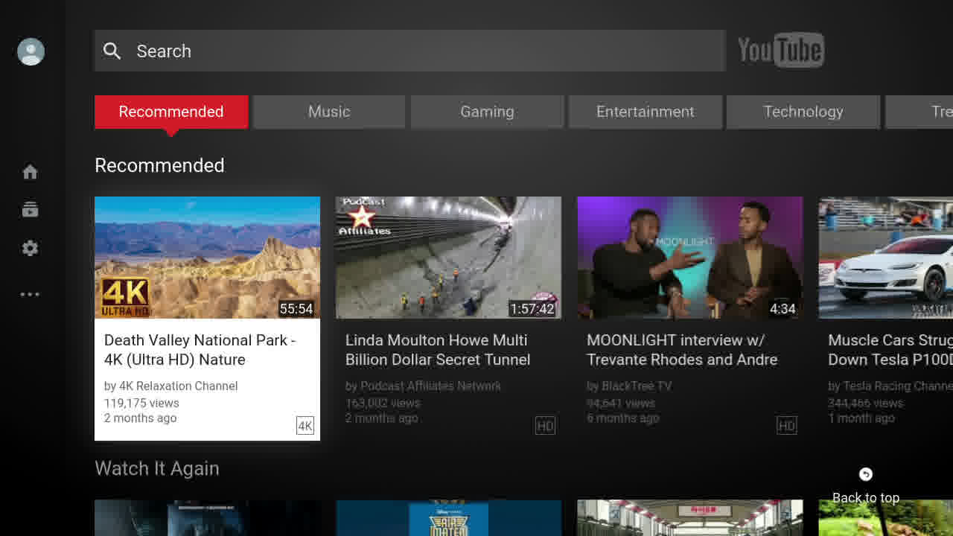
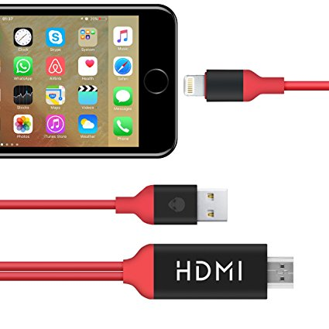
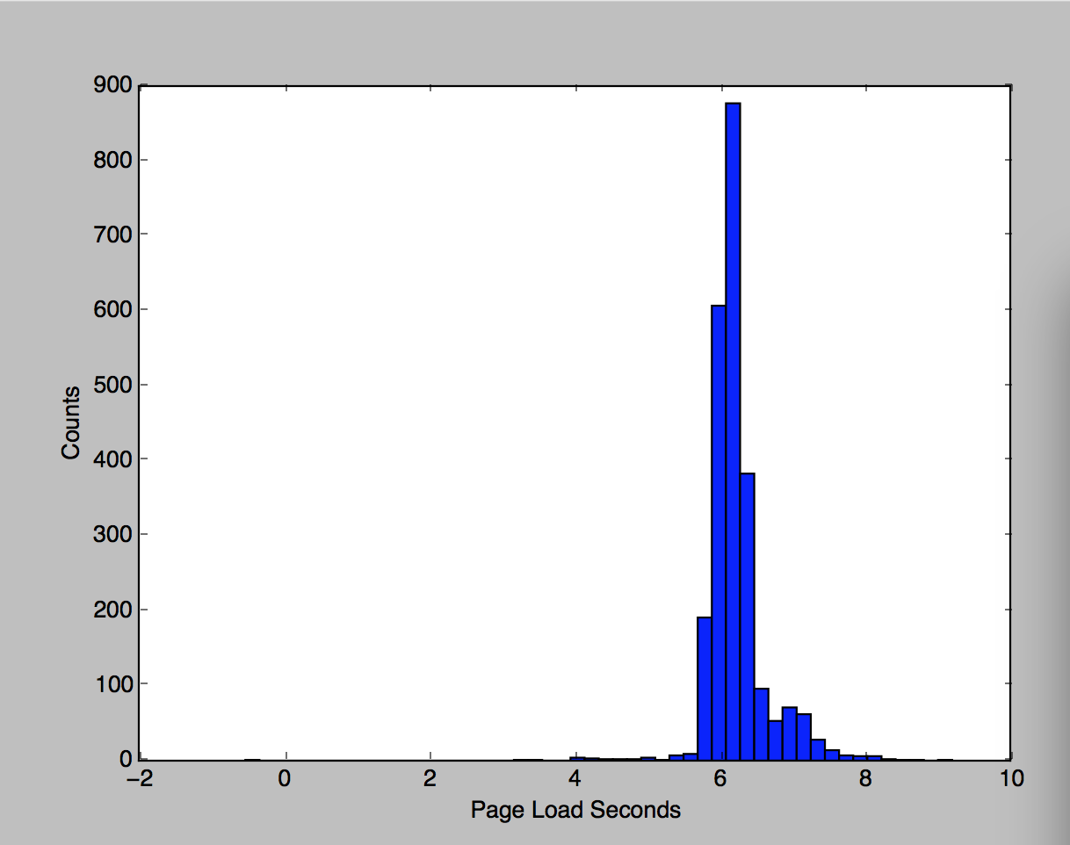
Automated Smart TV UI Performance
Testing with Visual Recognition
Peter Li, Ricky Lee
Motivation
Launch Time
Measurement
Smart TV applications such as YouTube and Netflix have performance requirements. YouTube certification program specifies requirements regarding UI performance for OEM providers, system integrators and smart TV vendors that wish to ship their devices with YouTube application.
In this project, we applied the current convolutional neural network based image classification algorithm to automation of Smart TV UI performance testing.
We got state-of-art model, which has 100% validate accuracy. Before we do the measurement, we use the training data calculated standard deviation, and use the std value with confidence level (90%) to measure the performance.
8.1 seconds
Data Acquisition
Conclusion & Future work
For image retrieval and collection, we used Decklink image capture card from BlackMagic [10], the capture is based on STB's output 720P, and frame rate is 60Hz, capturing 60 screenshots per second. The images were labeled in a semi-automated fashion: since the pages are shown sequentially, we used the average launch time and the average durations for which each page is displayed to roughly divide and save the images in subfolders. Then each folder was manually checked to move the wrongly assigned images to the correct folders.
Test Result
Each models are got almost 100% accuracy
Test Time using different model
Launch performance distribution
We successfully applied convolutional neural network knowledge on Automate Smart TV UI Performance Testing. And got state-of-art result on YouTube launch time measurement.
Similar pipeline and training procedure can be applied not only to similar UI performance testing of different applications, but also to all UI related test automation that requires similar computer vision capabilities. For example, similar system can be used to iOS and Android UI related test automation, because the details of the system can be adjusted to match iOS and Android UI's image resolutions and test criteria.
Classification Algorithm
We experimented different visual recognition machine learning algorithms on our dataset, such as Inception V3, 1-Hidden Layer CNN, SVM and k-NN.
Launch Performance Distribution

